Slide 1
Board Four The Audio Amplifier
The most challenging board yet.
Fourteen pads.
About 26 components.

Slide 2
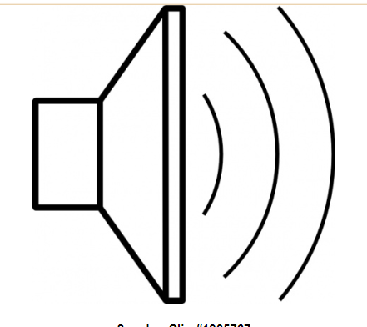
Review: Our Receiver We’ve been calling it the TJ 40 DC RX But can anyone think of a better name?
Bandpass
Filter
Mixer
Audio Amplifier
Oscillator
(VFO or PTO)

Slide 3
We have to take a VERY weak signal, and amplify it so that it will be audible.
The signal coming out of the mixer will be in the microvolt range.
We need to amplify this to the volt range
That is a lot of amplification.

Slide 4
We do this with 3 transistor amplifiers. Each boosts the signal and passes it on.

Slide 5
Be careful! We want amplifiers not an oscillator!
If some of the output signal gets back to the input: OSCILLATION!
We did this deliberately on your VFO/PTO. But not on this one!
Keep wire lengths short. Keep inputs far from outputs.
WE HAVE ALL HAD AMPLIFIERS THAT WANTED TO BE OSCILLATORS!

Slide 6
How a transistor amplifies: Small input signal controls a larger output signal.

Slide 7
Internal operation of transistor is fascinating. But it is best if you study this on your own.
Two books in the resource section of your shared drive:
SolderSmoke (by Bill)
From Atoms to Amperes by F.A. Wilson

Slide 8
Did anyone try to design this board?

Slide 9
Make Haste Slowly!
Your building skills are improving.
Be careful and methodical. But get it done.
Divide the board into thirds, then glue down the pads.
Build the first amplifier stage first. Test, then build the rest.

Slide 11
In Munich Germany – A very similar effort

Slide 12
This Week’s Award! First BP Filter! We’re calling this award “THE TORRY”

